Slide 1
HOW TO
EFFECTIVELY
HOME
WORK FROM

Slide 2
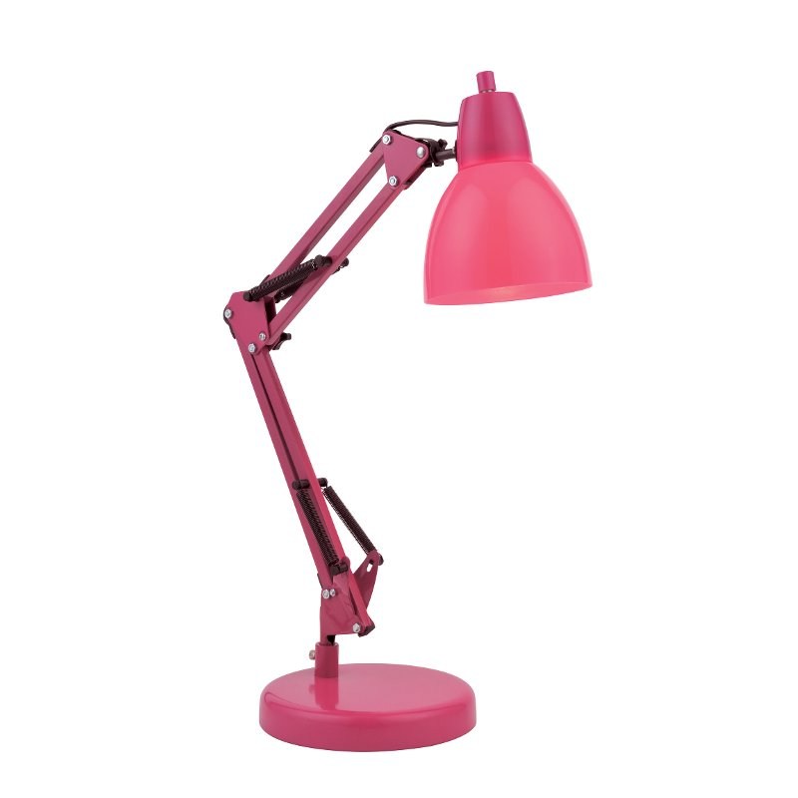
HOW TO EFFECTIVELY WORK FROM HOME:
OBJECTIVES
By the end of this short training, learners will be able to:
Identify the basic space and technology needs in a home office
Evaluate their individual needs and develop a plan for their home office
Construct a schedule to balance work and daily routines

Slide 3
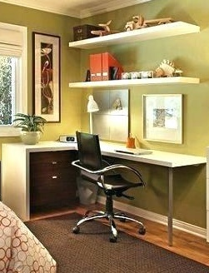
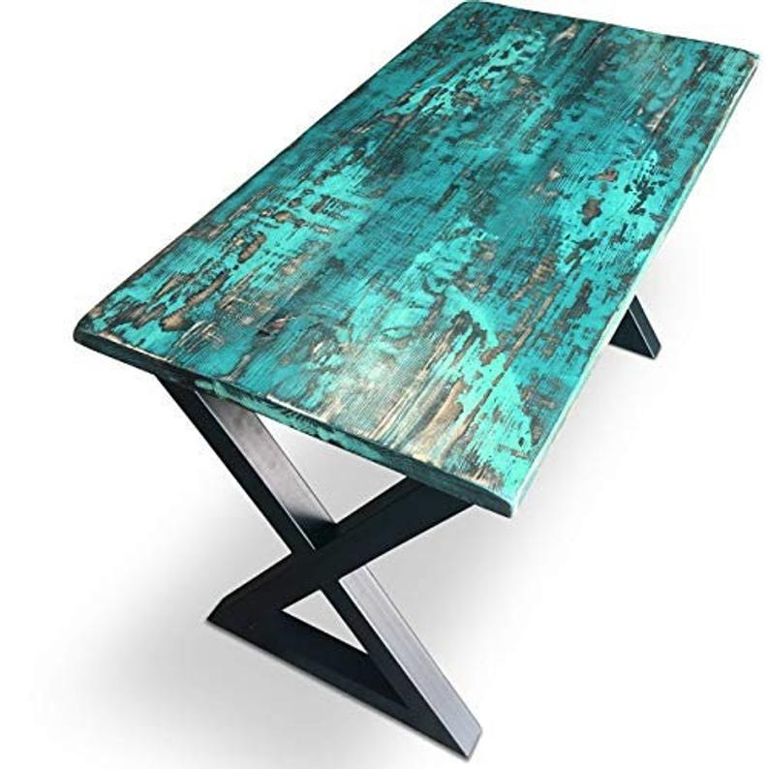
Workspace Setup
YOUR WORKSPACE:
Click to watch Ramon’s workspace success story!
THE ENVIRONMENT
To get the best results, you need the best setup.
A home office can be anything—and anywhere—you want. You'll want to define a professional work area that separates your business from your personal life whether you're self-employed or telecommuting. Its location, opportunity for privacy, confinement of clutter, and lighting are all important.
1
2
READ MORE
3
Set up a designated workspace
Location and privacy
Light up
Your space for productivity
You can always use part of the kitchen table as your office space— but resetting your office after every meal may not be optimal. You may have to think about using what space you do have creatively. Unused corners, large (but empty) closets, or spaces under the stairs can be converted to an office with a little bit of creativity.
Privacy—and quiet—can be difficult to come by in a home office. If you don’t have a separate room with a door, consider the location so you can add a privacy divider or curtains to your home office setup. Either approach is a generally inexpensive method of “closing the door” to your office.
Set up your home office where you get as much natural light as possible; it can help boost your productivity. Poor lighting in your office will cause headaches and eye strain − making you a less productive employee.
WFH TIP: Remember that a home office is tax deductible!

Slide 4
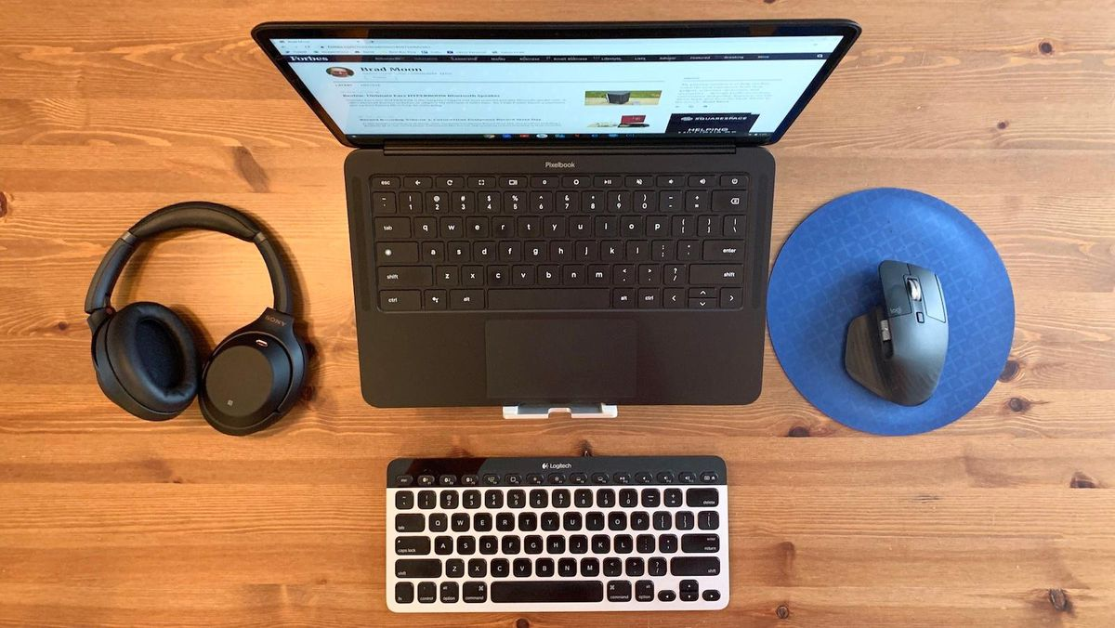
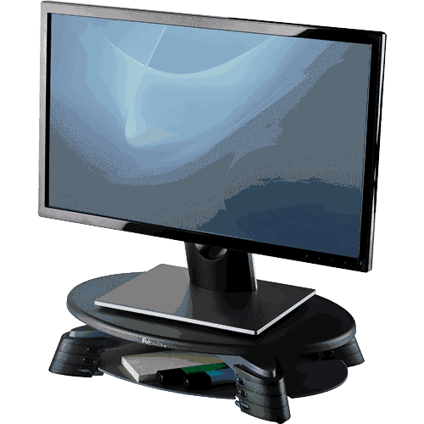
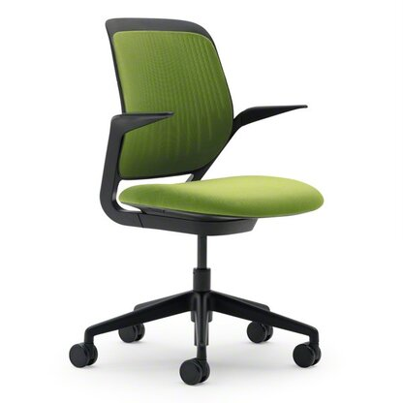
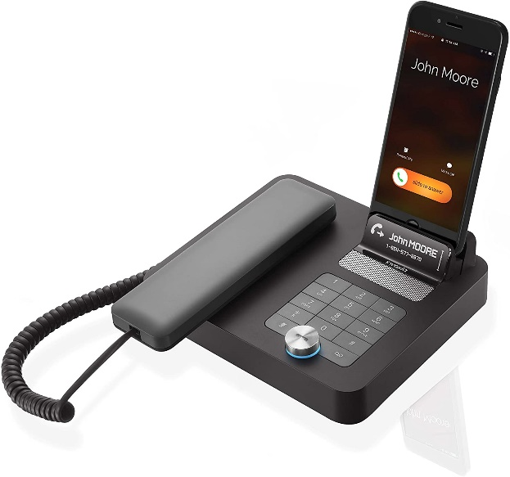
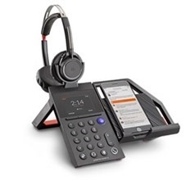
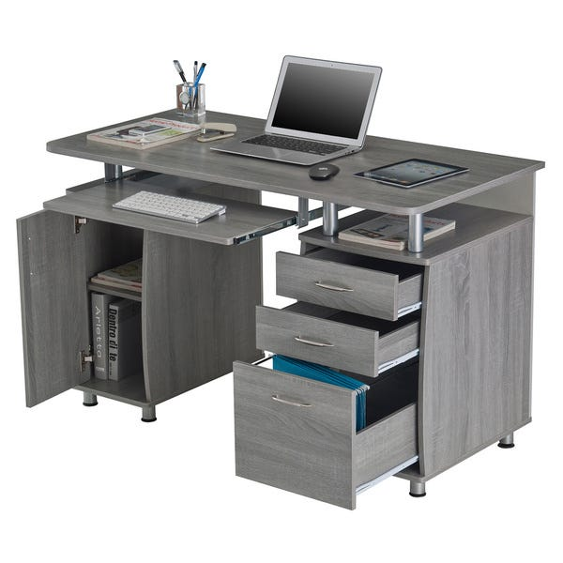
Workspace Setup
YOUR WORKSPACE:
TOOLS OF THE TRADE
What you’ll need depends upon the type of work you do.
Being successful in a home office requires creating a workspace in a non-traditional work environment. While your employer may have specific requirements about the equipment you must use (such as dedicated electronics or industry-specific equipment), begin with these basics.
1
2
READ MORE
3
Start with the communication basics
Prioritize ergonomics in your design
Your desk and storage spaces
Having a dedicated phone for your home office, including a cell phone or a VoIP—Internet-based—phone, can allow you to separate your work and personal life. If you use the same landline for your home and work, you risk having a child or other family member answer the phone.
Sitting at a desk for long hours without proper support for your back is a fast track to posture problems. Ergonomic office chairs offer the correct support when you’re sitting for long hours.
Don’t forget your neck and eyes, too. Make sure you’ve got your monitor in the “perfect” spot. You may need to invest in a screen riser to get the right adjustment.
Working at home means spending a lot of time at your desk. You want a desk that contributes to your productivity by helping you stay comfortable all day.
Dedicated storage
options can also be used to house files, papers, stationery, and more. There are many creative options you can use to immediately feel more organized.

Slide 5
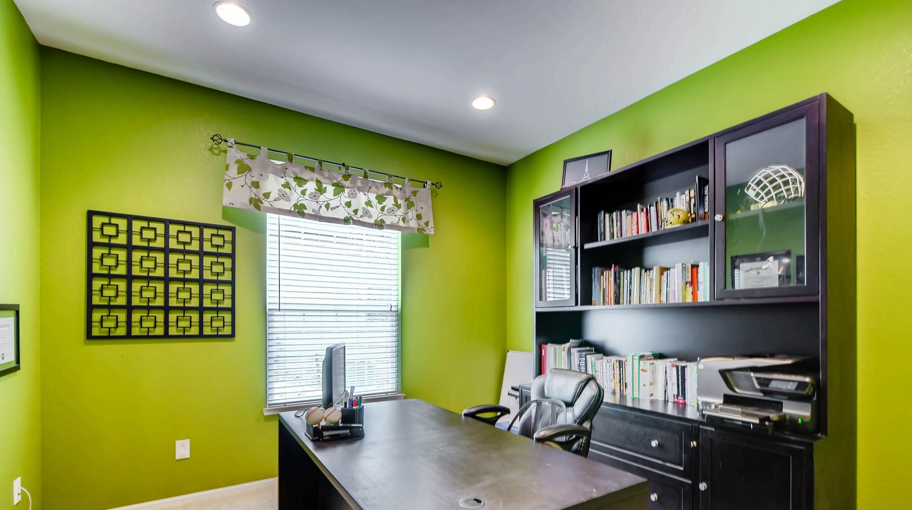
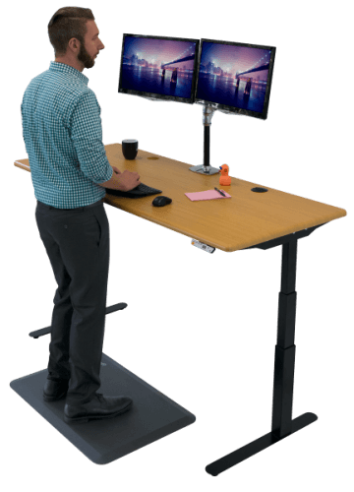
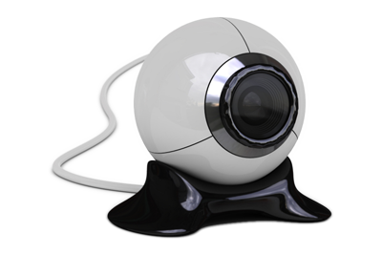
Workspace Setup
Go to the Outreach Slack Work-from-Home Group. Search for #WFH and tell the group about tools for productivity that you are using!
YOUR WORKSPACE:
YOUR WORKSPACE:
SET A SCHEDULE
TOOLS FOR PRODUCTIVITY
To get the best results, you need the best setup.
Now that I have the basics, what’s next?
You now have a dedicated workspace that is semi-private, well-lit, businesslike, attuned to your ergonomic needs, and is clutter-free. Now let’s take a brief look at some tools that will help you be more efficient and productive.
A home office can be anything—and anywhere—you want. You'll want to define a professional work area that separates your business from your personal life whether you're self-employed or telecommuting. Its location, opportunity for privacy, confinement of clutter, and lighting are all important.
1
2
3
Set up a designated workspace
Standing Desk
There is evidence that employing a standing desk can have long-term health benefits, even if you only stand for 30 minutes at a time.
Webcam
Webcams allow users to communicate with both audio and video technology, making the communication more sophisticated. Users can use the webcam to save videos they film to watch later or send to others.
Noise cancelling headphones
Noise-cancelling headphones offer excellent hearing protection against the constant levels of noise, You get much greater noise attenuation, The noise reduction works on all external noise, not just low-frequency continuous droning sound.
Location and privacy
Light up
Your space for productivity
You can always use part of the kitchen table as your office space— but resetting your office after every meal may not be optimal. You may have to think about using what space you do have creatively. Unused corners, large (but empty) closets, or spaces under the stairs can be converted to an office with a little bit of creativity.
Privacy—and quiet—can be difficult to come by in a home office. If you don’t have a separate room with a door, consider the location so you can add a privacy divider or curtains to your home office setup. Either approach is a generally inexpensive method of “closing the door” to your office.
Set up your home office where you get as much natural light as possible; it can help boost your productivity.
Poor lighting in your office will cause headaches and eye strain − making you a less productive employee.
SHOP NOW
Dual Monitors
A university study found 10% increases in productivity and 20% reduction in errors (plus reduced stress) for test workers that were using multiple monitors.
SHOP NOW
SHOP NOW
SHOP NOW

Slide 6
EXAMPLE SCHEDULE
EXAMPLE SCHEDULE
YOUR WORKDAY:
7:00 AM
Wake Up
Get up, get out of bed. Let the sunshine fill your head.
7:00 AM
Wake Up
Get up, get out of bed. Let the sunshine fill your head.
SET A SCHEDULE
7:30AM
Shower and get dressed
7:30AM
Shower and get dressed
To become successful, keep to a schedule.
8:00 AM
Start work
We can work from home, oh, oh, oh oh
We can work from home, oh, oh, oh oh
Whether you work in a temporary office setting or telecommute from home, you should abide by a self-imposed schedule. According to a recent study on efficient telecommuting work schedules, the key to crafting the perfect schedule is to plan out your workday.
8:00 AM
Start work
We can work from home, oh, oh, oh oh
We can work from home, oh, oh, oh oh
3
3
Light up
Your space for productivity
Light up
Your space for productivity
1
3
READ MORE
10:00 AM
BREAK
Start every workday as if you are going to the office
Step away from your desk and eat your lunch
10:00 AM
BREAK
12:00 PM
Lunch
Set up your home office where you get as much natural light as possible; it can help boost your productivity.
Poor lighting in your office will cause headaches and eye strain − making you a less productive employee.
Set up your home office where you get as much natural light as possible; it can help boost your productivity.
Poor lighting in your office will cause headaches and eye strain − making you a less productive employee.
Lunch
12:00 PM
You can’t let the comfort of being home prevent you from developing a, “going to the office” mindset every day.
By eating at regular intervals, you will break up the monotony of work, give you energy, and allow your mind to be refreshed.
3:00 PM
BREAK
3:00 PM
BREAK
2
4
5:00 PM
Off work
Decide your work hours, and stick to them
Accomplish all work hour and daily tasks
5:00 PM
Off work
Click to watch Monique’s schedule success story!
You must set your work hours; this will give you a routine to follow. Most importantly, it will offer your workdays a set structure.
Know what you must do during your work hours and do it. Get things done, then do it again tomorrow. Procrastination will impact your workload.
WFH TIP: Use your phone alarm to set reminders to get up and move!

Slide 7
Go to the Outreach Slack Work-from-Home Group. Search for #WFH and post about the routines that are most important to you!
YOUR WORKDAY:
MAINTAIN ROUTINES
You can only work your optimal best when you are healthy and alert.
Just because you may not work a typical workday in an office doesn’t mean you shouldn’t try to create, and stick, to a self-imposed work schedule. When you work remotely, you will be sitting down for prolonged periods of time. Establish time in your routine for thirty minutes or more of daily exercise as well as periods where you can refresh your mind.
READ MORE
Keep your regular routines
Wake up, get dressed, do your normal morning routine.
A change of scenery will energize you
Go to your local coffee shop; do some work in a nearby park.
Take a walk to get some exercise
Stroll around the block, take your dog for a walk, etc.
Schedule time for a favorite hobby
Engaging your mind with something you enjoy will refresh you.

Slide 8
HOW TO EFFECTIVELY WORK FROM HOME:
RESOURCES
Setting up your home office means you’ve got a lot of choice and freedom. Review some of these
Additional resources to learn even more!
Whether you work in a temporary office setting or telecommute from home, you should abide by a self-imposed schedule. According to a recent study on efficient telecommuting work schedules, the key to crafting the perfect schedule is to plan out your workday.
Helpful Links
Video Tutorials
Social Connections
How to Set Up a Home Office You Love: 12 Tips
Setting Up Your Home Office
How to Craft the Perfect Schedule to Work from Home
10 Cool Home Office Design Ideas
DIY Home Office and Desk Tour
Keep Productive YouTube Channel
Outreach Slack Work-from-Home Group #WFH
HGTV Home Office Facebook Group
Google+ Remote Workers Community

