Slide 1
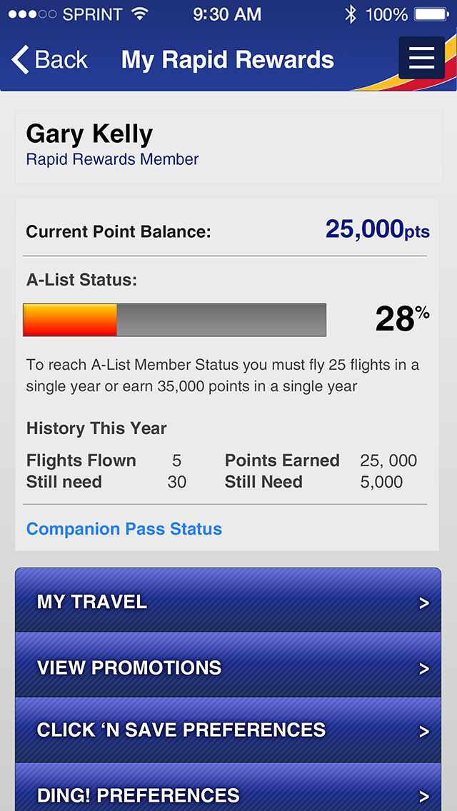
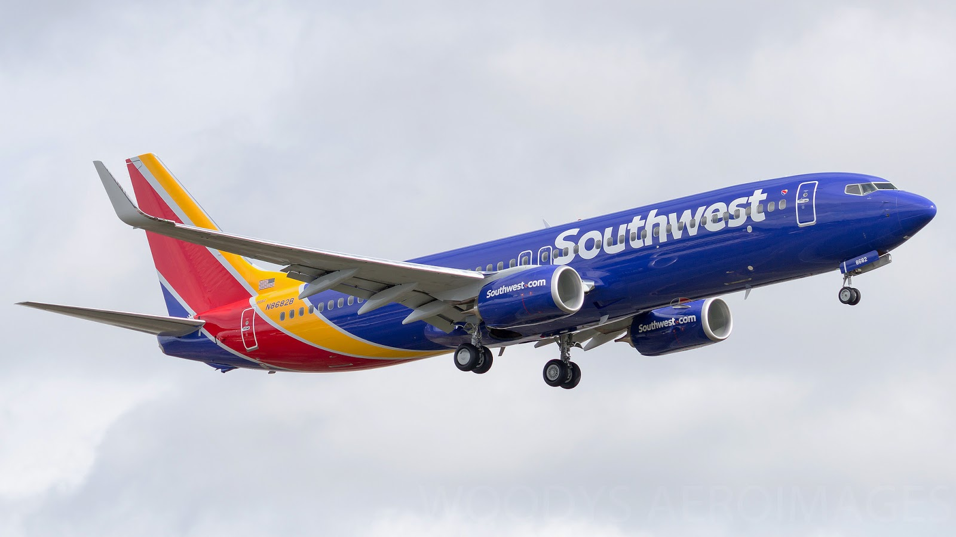
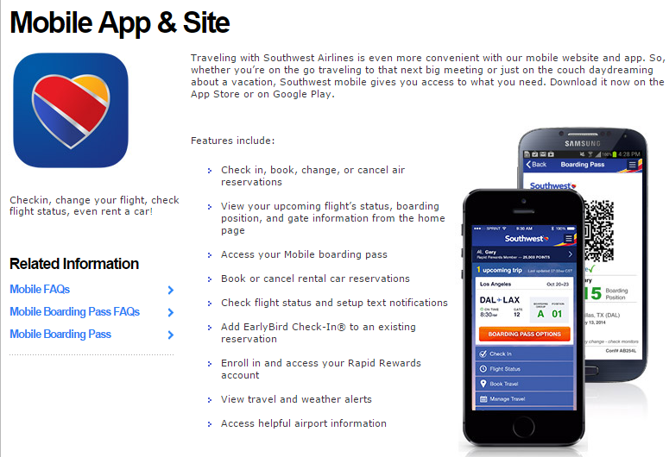
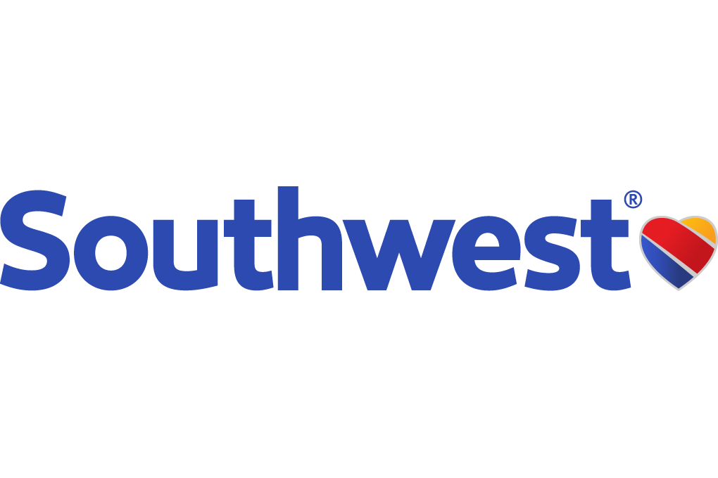
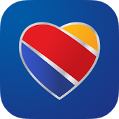
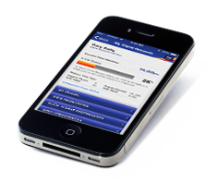
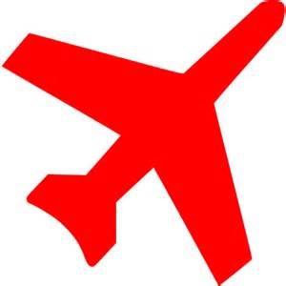
Customer Scenario 1: Acquisition and Postbacks
KEY SUCCESSES NEEDED
Customer Scenario 1: Acquisition and Postbacks
Background:
Southwest has a new app launching this fall targeting the most elite business SWABiz Rapid Rewards travelers. We have a limited promotion budget and need unique ways to promote our app so that we can get as many members as we can to take advantage of the new geo-location features that are included that will enhance their on-trip travel experience.
Southwest is planning an email campaign and a display advertising campaign to promote the app. The email campaign will be a series of emails until the member downloads the app. Then they will fall out of the workflow to receive emails.
The display advertising campaign will be through a segment/audience that will direct the ad to show creative through our display ad purchases and through Adobe Target on the SWABiz web pages and the home page for specific placements. They should stop seeing the ads after they have downloaded the app.
App Downloads
Opened and Used the App
Reuse of the App
App Deletes
NEW APP
Southwest has a new app launching this fall targeting the most elite business SWABiz Rapid Rewards travelers.
EMAIL CAMPAIGN
Southwest is planning an email campaign and a display advertising campaign to promote the app.
DISPLAY ADVERTISING
The display advertising campaign will be through a segment/audience.
Key Successes Needed:
Ad Suppression Once the Member has downloaded the app – no more messaging promoting the download.
Key Tracking Metrics Needed to show which members have downloaded and the success of the advertising.
App Downloads
Opened and Used the App
Reuse of the App
App Deletes
What will
Have at
completion?
Ad Suppression
Once the Member has downloaded the app;
no more messaging
promoting the download
Key Tracking Metrics
Needed to show which members have downloaded and the success of the advertising
Notes:
Background:
Southwest has a new app launching this fall targeting the most elite business SWABiz Rapid Rewards travelers. We have a limited promotion budget and need unique ways to promote our app so that we can get as many members as we can to take advantage of the new geo-location features that are included that will enhance their on-trip travel experience.
Southwest is planning an email campaign and a display advertising campaign to promote the app. The email campaign will be a series of emails until the member downloads the app. Then they will fall out of the workflow to receive emails.
The display advertising campaign will be through a segment/audience that will direct the ad to show creative through our display ad purchases and through Adobe Target on the SWABiz web pages and the home page for specific placements. They should stop seeing the ads after they have downloaded the app.
Key Successes Needed:
Ad Suppression
-Once the Member has downloaded the app – no more messaging promoting the download.
Key Tracking Metrics
-Needed to show which members have downloaded and the success of the advertising.
App Downloads
Opened and Used the App
Reuse of the App
App Deletes

Slide 2
Customer Scenario 1: Acquisition and Postbacks
Customer Scenario 1: Acquisition and Postbacks
At the completion of this process,
Background:
Southwest has a new app launching this fall targeting the most elite business SWABiz Rapid Rewards travelers. We have a limited promotion budget and need unique ways to promote our app so that we can get as many members as we can to take advantage of the new geo-location features that are included that will enhance their on-trip travel experience.
Southwest is planning an email campaign and a display advertising campaign to promote the app. The email campaign will be a series of emails until the member downloads the app. Then they will fall out of the workflow to receive emails.
The display advertising campaign will be through a segment/audience that will direct the ad to show creative through our display ad purchases and through Adobe Target on the SWABiz web pages and the home page for specific placements. They should stop seeing the ads after they have downloaded the app.
the client will have …
EMAIL CAMPAIGN An Email campaign series that sends an email to the qualified member.
ANALYTICS
Analytics on the App for Click through, download, and view/use.
UNSUBSCRIBED
Be unsubscribed to marketing messages after they download.
Key Successes Needed:
Ad Suppression Once the Member has downloaded the app – no more messaging promoting the download.
Key Tracking Metrics Needed to show which members have downloaded and the success of the advertising.
App Downloads
Opened and Used the App
Reuse of the App
App Deletes
Notes:
At Completion Southwest will have:
An Email campaign series that sends an email to the qualified member.
Analytics on the App for Click through, download, and view/use.
Be unsubscribed to marketing messages after they download.

Slide 3
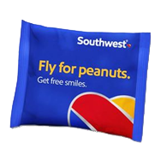
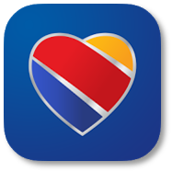
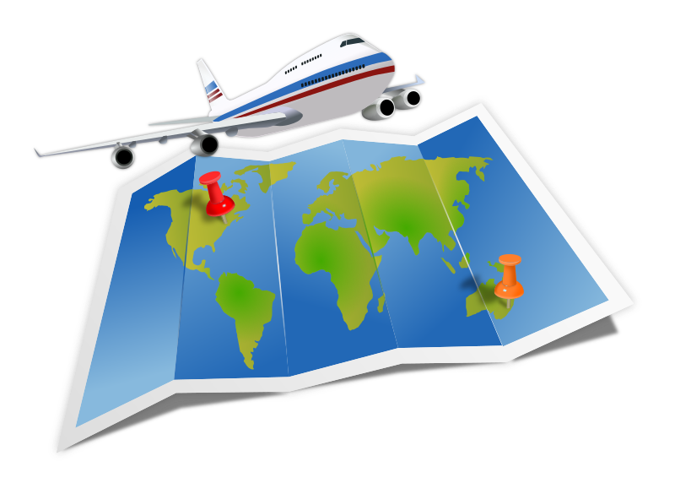
Customer Scenario 1: Acquisition and Postbacks
KEY SUCCESSES NEEDED
Customer Scenario 2: Marketing Engagement
Background:
Southwest has a new app launching this fall targeting the most elite business SWABiz Rapid Rewards travelers. We have a limited promotion budget and need unique ways to promote our app so that we can get as many members as we can to take advantage of the new geo-location features that are included that will enhance their on-trip travel experience.
Southwest is planning an email campaign and a display advertising campaign to promote the app. The email campaign will be a series of emails until the member downloads the app. Then they will fall out of the workflow to receive emails.
The display advertising campaign will be through a segment/audience that will direct the ad to show creative through our display ad purchases and through Adobe Target on the SWABiz web pages and the home page for specific placements. They should stop seeing the ads after they have downloaded the app.
TRANSFARENCY OFFERS
Southwest needs a connected experience to personalize “Transfarency offers” for a consistent experience.
TOP DESTINATIONS
We have our top 25 destination cities and we want to sent those offers out based on previous travel.
FLIGHT BOOKING
The ultimate goal is for Southwest is to get a flight booking from our advertising and make it the most efficient path for our customer.
Key Successes Needed:
Ad Suppression Once the Member has downloaded the app – no more messaging promoting the download.
Key Tracking Metrics Needed to show which members have downloaded and the success of the advertising.
App Downloads
Opened and Used the App
Reuse of the App
App Deletes
What will
Have at
completion?
Create One Offer
Creative and distribute
to multiple channels
Ads Targeted
On behaviors
Conversion
Toward a travel
booking
Notes:
Background:
Southwest needs a connected experience to personalize “Transfarency offers” for a consistent experience based on device & channel our customer is using to book travel. Southwest wants to make sure the messaging is the same if the customer has shown interest in a particular city we have a sale offer we are promoting. For example, if they are researching on their phone and get interrupted, we’d like this same offer to be shown to them that they were interested in when they come to the site on their desktop.
We have our top 25 cities that we want to push (e.g., Las Vegas, New York, Honolulu, Orlando, etc.) and we want to sent those offers out based on your previous travel, shown interest in that city within the last 30 days, or based on just general “shopping” behavior a customer has done on any device.
The ultimate goal is for Southwest is to get a flight booking from our advertising (through email, web, mobile, display, social) and make it the most efficient path for the customer.
Key Successes Needed:
Create one offer creative and distribute to multiple channels.
Ads targeted on behaviors.
Conversion towards a travel booking.

Slide 4
Customer Scenario 1: Acquisition and Postbacks
Customer Scenario 1: Acquisition and Postbacks
At the completion of this process,
Background:
Southwest has a new app launching this fall targeting the most elite business SWABiz Rapid Rewards travelers. We have a limited promotion budget and need unique ways to promote our app so that we can get as many members as we can to take advantage of the new geo-location features that are included that will enhance their on-trip travel experience.
Southwest is planning an email campaign and a display advertising campaign to promote the app. The email campaign will be a series of emails until the member downloads the app. Then they will fall out of the workflow to receive emails.
The display advertising campaign will be through a segment/audience that will direct the ad to show creative through our display ad purchases and through Adobe Target on the SWABiz web pages and the home page for specific placements. They should stop seeing the ads after they have downloaded the app.
the client will have …
CAMPAIGN SHOWCASE A campaign that will showcase the desired promotional ad shown on any device/channel.
AUDIENCES
Audiences created to target for these cities.
CONNECTED ADS
Connected ads throughout devices for an audience. .
Key Successes Needed:
Ad Suppression Once the Member has downloaded the app – no more messaging promoting the download.
Key Tracking Metrics Needed to show which members have downloaded and the success of the advertising.
App Downloads
Opened and Used the App
Reuse of the App
App Deletes
Notes:
At Completion Southwest will have:
A campaign that will showcase the desired promotional ad shown on any device/channel.
Audiences created to target for these cities.
Connected ads throughout devices for an audience.

Slide 5
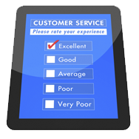
Customer Scenario 1: Acquisition and Postbacks
KEY SUCCESSES NEEDED
Customer Scenario 3: Personalization
Background:
Southwest has a new app launching this fall targeting the most elite business SWABiz Rapid Rewards travelers. We have a limited promotion budget and need unique ways to promote our app so that we can get as many members as we can to take advantage of the new geo-location features that are included that will enhance their on-trip travel experience.
Southwest is planning an email campaign and a display advertising campaign to promote the app. The email campaign will be a series of emails until the member downloads the app. Then they will fall out of the workflow to receive emails.
The display advertising campaign will be through a segment/audience that will direct the ad to show creative through our display ad purchases and through Adobe Target on the SWABiz web pages and the home page for specific placements. They should stop seeing the ads after they have downloaded the app.
APP
ENGAGEMENT
Give my customers a reason to engage with our app.
SPECIAL
OFFERS
Surprise and delight the customer with a special offer for a free drink by sending a scanable coupon to their phone.
CUSTOMER
SURVEY
Upon returning from their trip, send a customer survey (via a mobile app or email) to collecte info on their experience.
Key Successes Needed:
Ad Suppression Once the Member has downloaded the app – no more messaging promoting the download.
Key Tracking Metrics Needed to show which members have downloaded and the success of the advertising.
App Downloads
Opened and Used the App
Reuse of the App
App Deletes
What will
Have at
completion?
Geo-location
Based Targeting
iBeacon
for terminal lounge send messages
Create Offers
for coupons
and surveys
Analytics
Who took
advantage?
Notes:
Background:
My overall goal is to give my customers a reason to engage with our app. We love to do “surprise and delight” type messaging to our customers while they are on trip to make their experience with us memorable. We have a new lounge & a new terminal in an airport. If one of our customers is visiting that airport and/or walks past the lounge, we want thank them for their loyalty & to alert them to their privileges & get them to stop in. We might even want to send them a text if we know this airport is in their travel plans for the day based on their trip itinerary.
If they come into the lounge, we want to Surprise and Delight them with a special offer for a free drink by sending a scanable coupon to their phone. We want them to explore as much of this new lounge as possible and potentially take pictures and share socially.
Finally, in order to get feedback for enhancements, when the customer has returned from the trip – we’d like to be able to send a survey through their mobile app or email that allows them to tell us about their experience.
Key Successes Needed:
Be able to used geo-location based targeting.
Have an Ibeacon for a specific terminal lounge send messages.
Create offers with deep linking for coupons and surveys.
Have analytics around who took advantage of this messaging.
At Completion Southwest will have:
Location tracking for success of physical event.
Deep linking of promotional events during and after the event.
Tracking of desired behaviors from follow up communications.

Slide 6
Customer Scenario 1: Acquisition and Postbacks
Customer Scenario 1: Acquisition and Postbacks
At the completion of this process,
Background:
Southwest has a new app launching this fall targeting the most elite business SWABiz Rapid Rewards travelers. We have a limited promotion budget and need unique ways to promote our app so that we can get as many members as we can to take advantage of the new geo-location features that are included that will enhance their on-trip travel experience.
Southwest is planning an email campaign and a display advertising campaign to promote the app. The email campaign will be a series of emails until the member downloads the app. Then they will fall out of the workflow to receive emails.
The display advertising campaign will be through a segment/audience that will direct the ad to show creative through our display ad purchases and through Adobe Target on the SWABiz web pages and the home page for specific placements. They should stop seeing the ads after they have downloaded the app.
the client will have …
LOCATION TRACKING Location tracking for success of physical event.
DEEP LINKING
Deep linking of promotional events during and after the event.
BEHAVIOR TRACKING
Tracking of desired behaviors from follow up communications.
Key Successes Needed:
Ad Suppression Once the Member has downloaded the app – no more messaging promoting the download.
Key Tracking Metrics Needed to show which members have downloaded and the success of the advertising.
App Downloads
Opened and Used the App
Reuse of the App
App Deletes
Notes:
At Completion Southwest will have:
Location tracking for success of physical event.
Deep linking of promotional events during and after the event.
Tracking of desired behaviors from follow up communications.

Slide 7
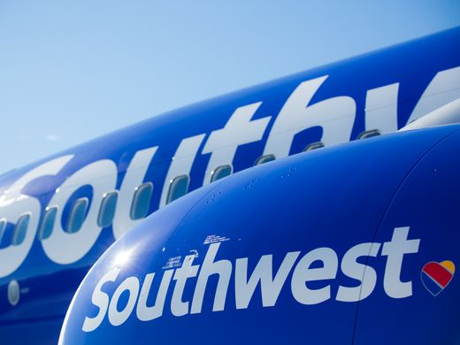
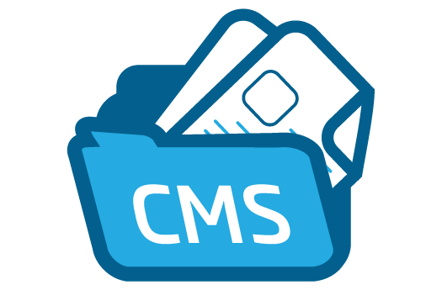
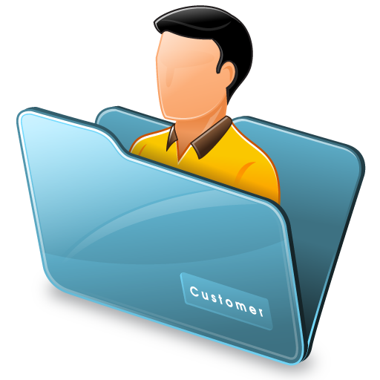
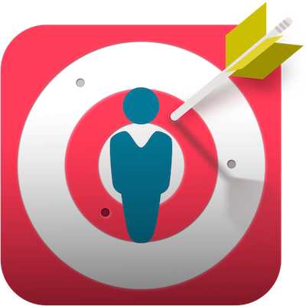
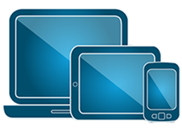
The Business’ Wish List of Capabilities from Southwest Airlines
Southwest thinks that a disconnected experience is the number one reason shoppers do not turn into customers
I want to be able to create, manage & deliver seamless experiences across all devices & have a foundation to support experiences across all channels and devices.
I want to be able to create content once and deploy it across all customer interactions, including online and offline, for a consistent experience from one central platform.
I need to be able to aggregate customer traits from various touchpoints and sources to create a unified customer profile that you can target across channels.
I need automated targeting based on user behavior, profile data, and algorithmic models help you provide 1-to-1 personalization. I want to be able to deliver contextual, personalized experiences that drive deeper engagement and conversions.
I need to be able to analyze and track all my app interactions. Starting with the acquisition of my app from the store and through it’s continued use or deletion. If I could know more about my customer’s interaction with my brand he had on various devices, I could deliver a better customer experience.
I need to be able to analyze and act on customer data. Meaning that I can combine and analyze online and offline data to gain a customer-centric view and identify segments to improve the overall customer journey.
I want to easily be able to test and optimize user experiences. By easily set up A/B and multivariate testing and deliver targeted experiences to customer segments.
Southwest thinks that a disconnected experience is the number one reason shoppers do not turn into customers.
Deliver consistent and connected experiences on any device, in any channel, at any time by consolidating online and offline customer data.
Create content once and deploy it across all customer interactions to ensure each customer’s experience is relevant and personal
Aggregate customer traits from various touchpoints (cross device & multi-channels and sources to create a unified customer profile
Formulate audience intelligence to match customers with the appropriate experiences in real time and based on prior behaviors across devices
Analyze user data to gain customer insight and optimize experiences across all devices and channels
Integrated testing to determine relevant, personalized, and optimized experiences
Notes:
How are you meeting your customers’ expectations for a consistent, personalized experience whenever and wherever they engage with you (across channels and devices)?
• How are you making sense of all the customer data (behavioral, transactional, demographic) that you’re collecting and using it to deliver an optimal experience across your digital and traditional channels? Retail
• How do you currently personalize the customer experience across the various touch points? Desktop? Mobile? Tablet? In-Store Kiosk? Call Center?
• How are you providing a differentiated ecommerce experience for your customers? Travel and HospitalityHow do your booking and travel services experiences meet customer expectations when they’re using their mobile devices?
• How are you meeting your customers’ expectations for a consistent, personalized experience whenever and wherever they engage with you (across channels and devices)?
• How are you making sense of all the customer data (behavioral, transactional, demographic) that you’re collecting and using it to deliver an optimal experience across your digital and traditional channels?
• How do you currently personalize the customer experience across the various touch points - desktop, mobile, tablet, in-store kiosk, and call center?
• How are you providing a differentiated ecommerce experience for your customers?
How well do your booking and travel services experiences meet customer expectations when they’re using their mobile devices?

